Slide 1
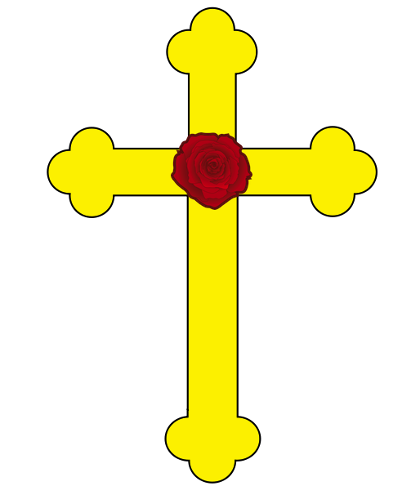
ANGELS AND ATOMS The Rosicrucian Ideal

Slide 2
What we Know The historical backdrop Where is began How it began what it became What we don’t know Who wrote the original documents What was the original intention
https://www.wsj.com/articles/how-roses-came-to-mean-true-love-11613192460

Slide 3
The historical backdrop

Slide 4
Where it Began
http://www.saburchill.com/history/chapters/chap5117.html

Slide 5
How it began
wikepedia

Slide 6
The Legend
https://sria.org/the-rosicrucian-vault/

Slide 7
Who and Why
Wikipedia

Slide 8
The immediate aftermath

Slide 9
Initial commentaries and the end of the Furor
Wikipedia

Slide 10
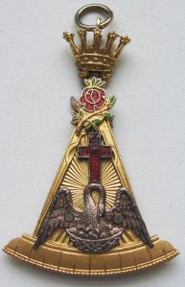
Resurrection

Slide 11
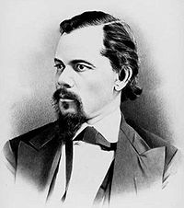
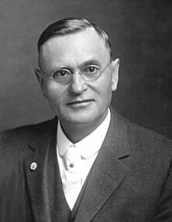
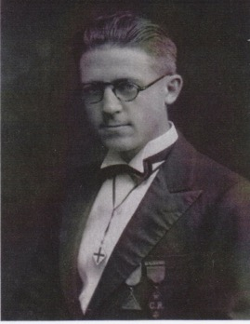
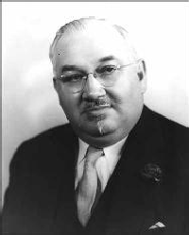
America

Slide 12
Modern venues
Correspondence
Study Group
Practicing
Academic

Slide 13
The Original Intention
Wikipedia

Slide 14
General Characteristics non-dogmatically Christian

Slide 15
General Characteristics Scholarship

Slide 16
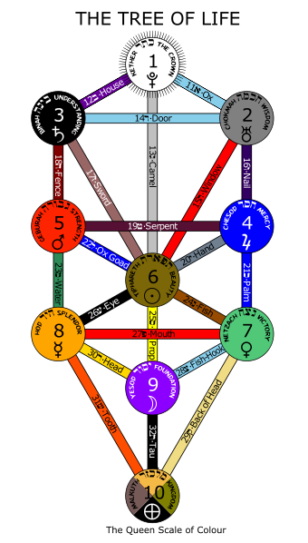
Qabalah

Slide 17
Alchemy
https://www.deviantart.com/themrparticleman/art/The-Alchemic-Tree-of-Life-New-Alchemical-Tool-552324333

Slide 18
Rosicrucians and Freemasons
For what we do presage is not in grosse, For we are brethren of the Rosie Crosse; We have the Mason Word and second sight, Things for to come we can foretell aright.
— Henry Adamson, The Muses' Threnodie (Perth, 1638).

Slide 19
Stations and places
Rosicrucianism
Freemasonry

Slide 20
 | Masonic | Rosicruican
Origin | (like) Scotland | Central Europe
Progression | Organization before content | Content before organization
Metaphor | Architecture | Spiritual Alchemy
Method | Ritual | Study-Research-Practice-Ritual
Focus | Social-Charitable- Philosophical | Philosophical-Social-Chartable
Central Personality | Hiram Abif | Christian Rosenkreuz
Central Location | King Solomon's Temple | The Vault of the Adepti
Religious Requirement | Initially Christian, later non-specific monotheistic | Christian
https://www.wsj.com/articles/how-roses-came-to-mean-true-love-11613192460

Slide 21
Societas Rosicruciana in Civitatibus Foederatis

Slide 22
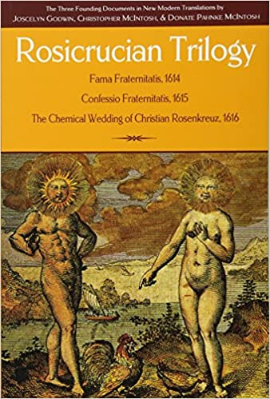
The Rosicrucian Trilogy joscelyn Goodwin Christoper mcintosh donate pahnke mcintosh

Slide 23
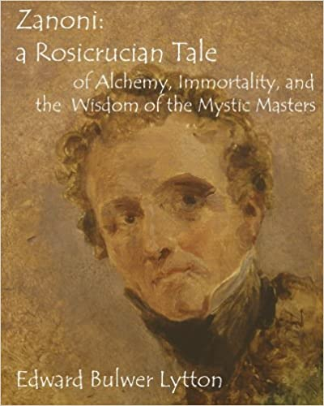
Zanoni: Rosicrucian tale Edward bulwer lytton

Slide 24
The Rosicrucian Enlightment Francis A. Yates

Slide 25
The brotherhood of the rosy Cross Arthur Edward waite

Slide 26
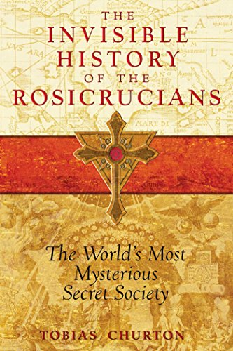
The Invisible history of the Rosicrucian Enlightment tobias churton

Slide 27
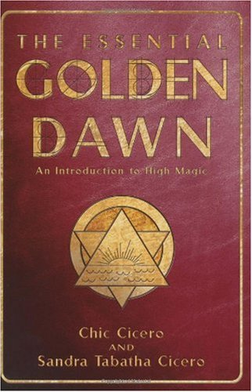
The Essential golden dawn Chic cicero Sandra tabatha cicero

