Slide 1
A STUDY ABOUT JOHN THE BAPTIST By W. Bruce Pruitt, PM, GC, HPGM Presented to Golden State College SRICF Los Altos, CA February 26, 2023

Slide 2
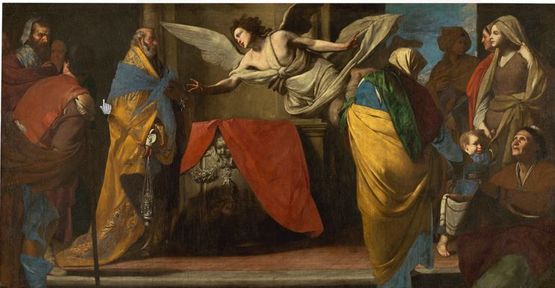
The Birth of John the Baptist announced to Zacharias by Massimo Stanzione

Slide 3
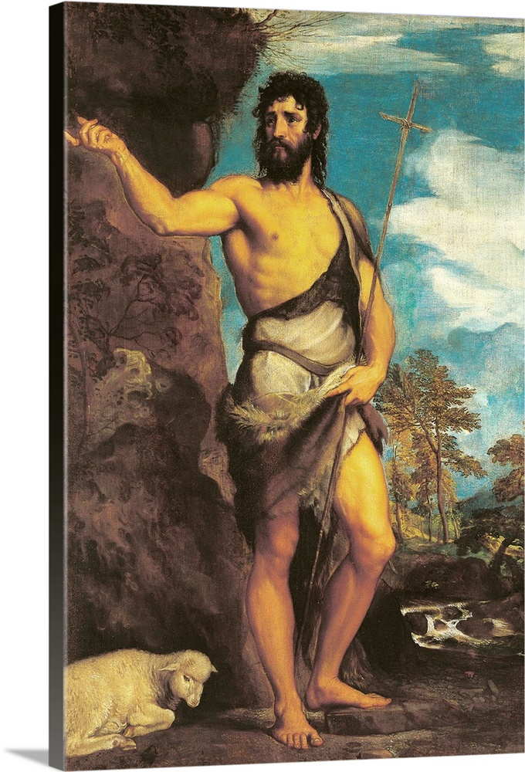
Saint John the Baptist by Tiziano Vecellio (Titian)

Slide 4
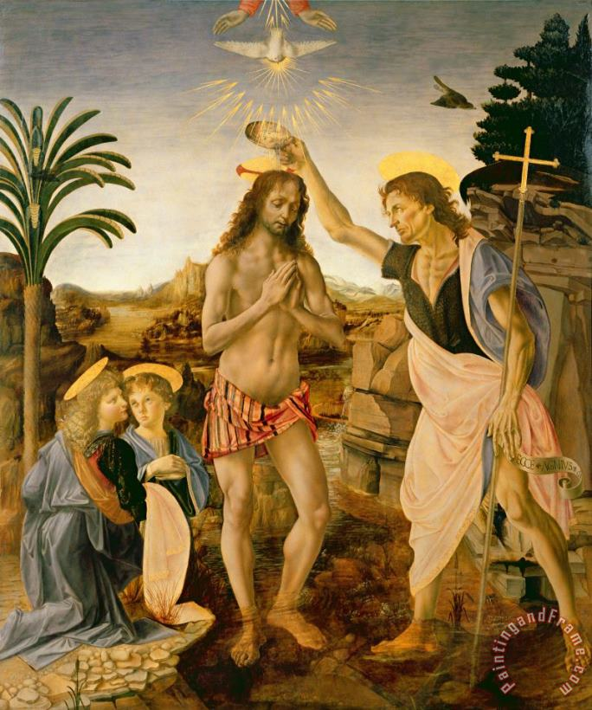
The Baptism of Christ (by Saint John the Baptist) by Leonardo da Vinci

Slide 5
Saint John the Baptist Preaching by Luca Giordano

Slide 6
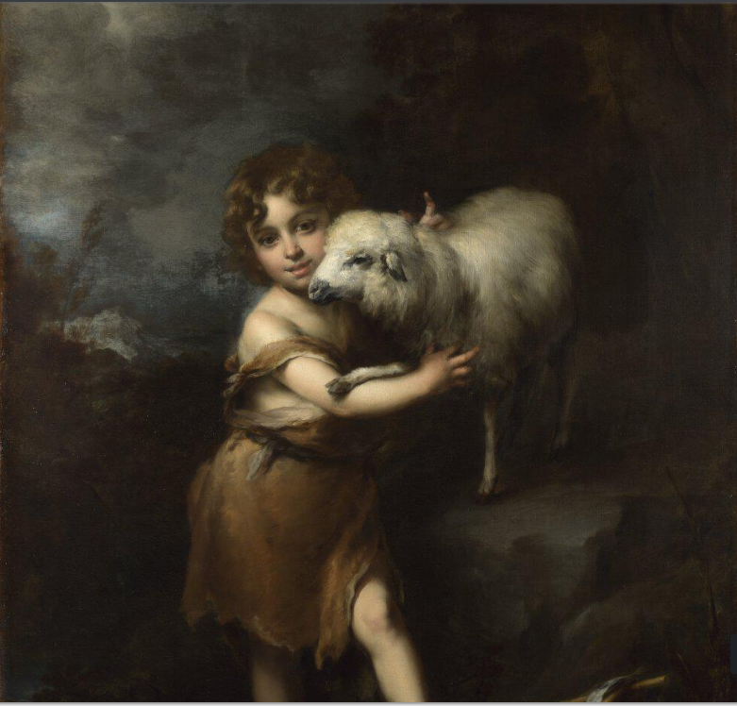
The Infant Saint John with the Lamb by Bartolomé Esteban Murillo

Slide 7
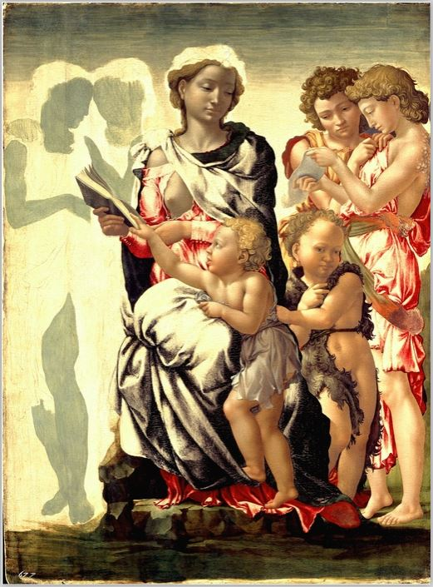
Madonna and Child and St. John and the Angels by Michelangelo Buonarroti

Slide 8
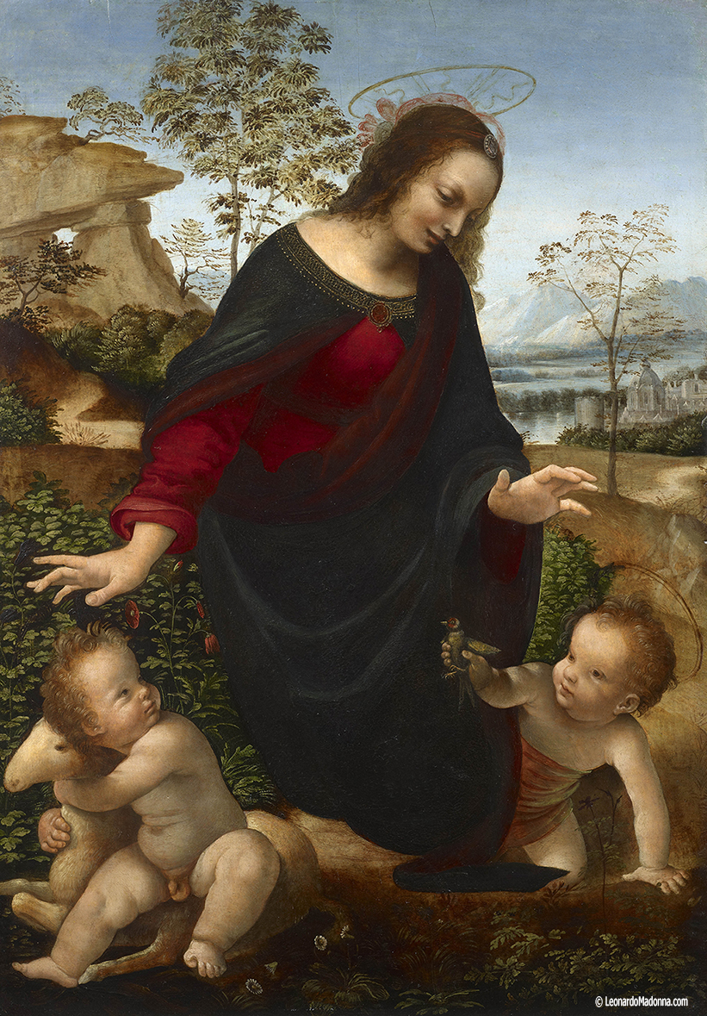
Madonna and Child with the Infant Saint John the Baptist by Leonardo da Vinci

Slide 9
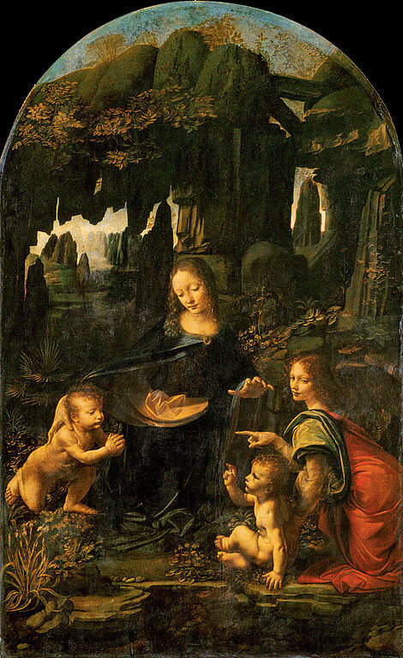
Virgin of the Rocks by Leonardo da Vinci (the Louvre)

Slide 10
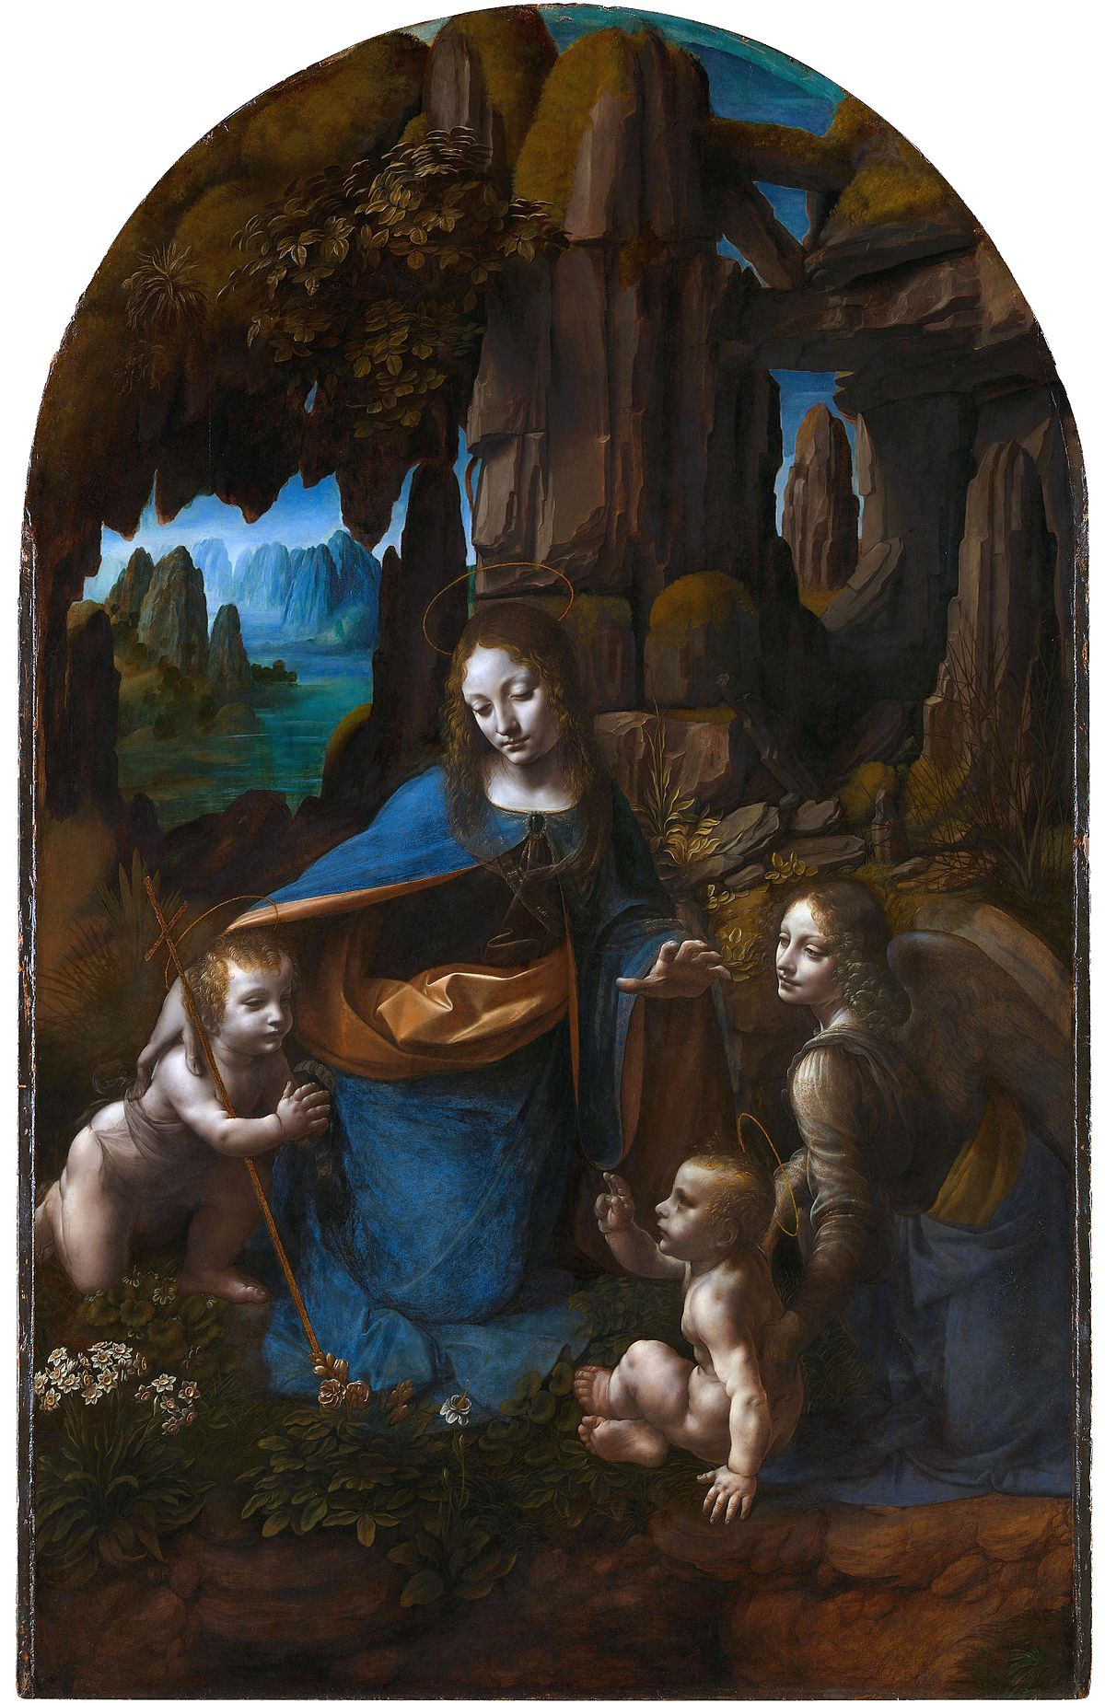
Virgin of the Rocks by Leonardo da Vinci (National Gallery London)

Slide 11
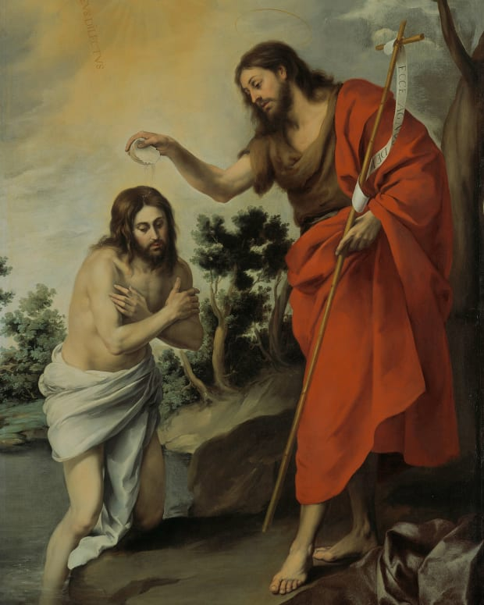
Baptism of the Lord by Bartolome Murillo

Slide 12
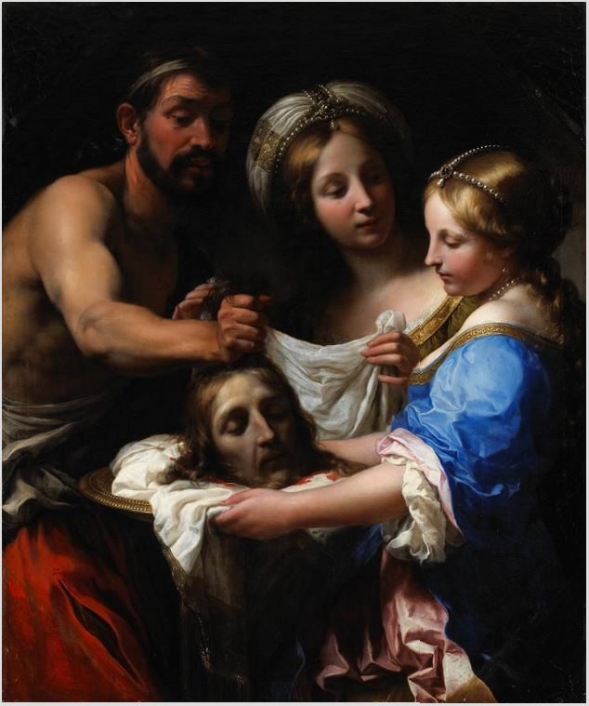
Salome with the Head of Saint John the Baptist by Onorio Marinari

Slide 13
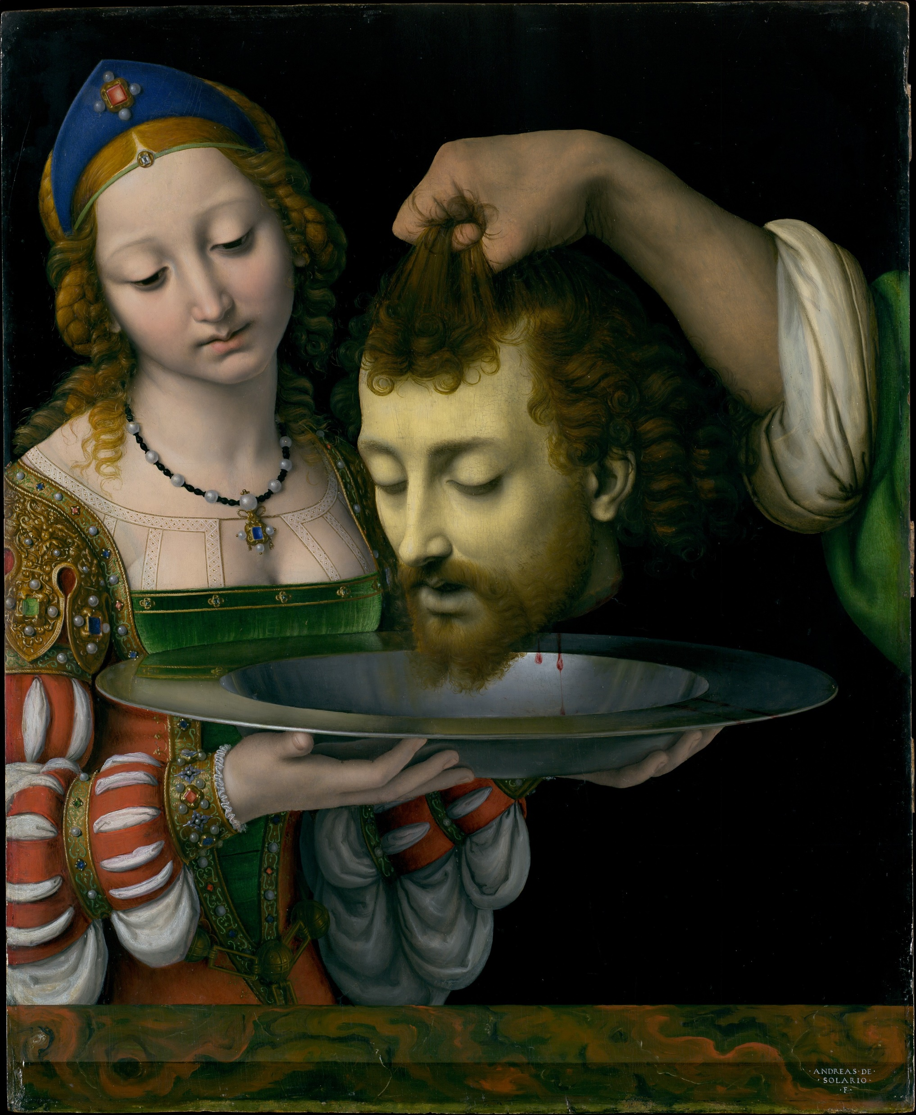
Salome with the Head of Saint John the Baptist by Andrae Solorio

Slide 14
The Baptism of Christ (by Saint John the Baptist) by Leonardo da Vinci

Slide 16
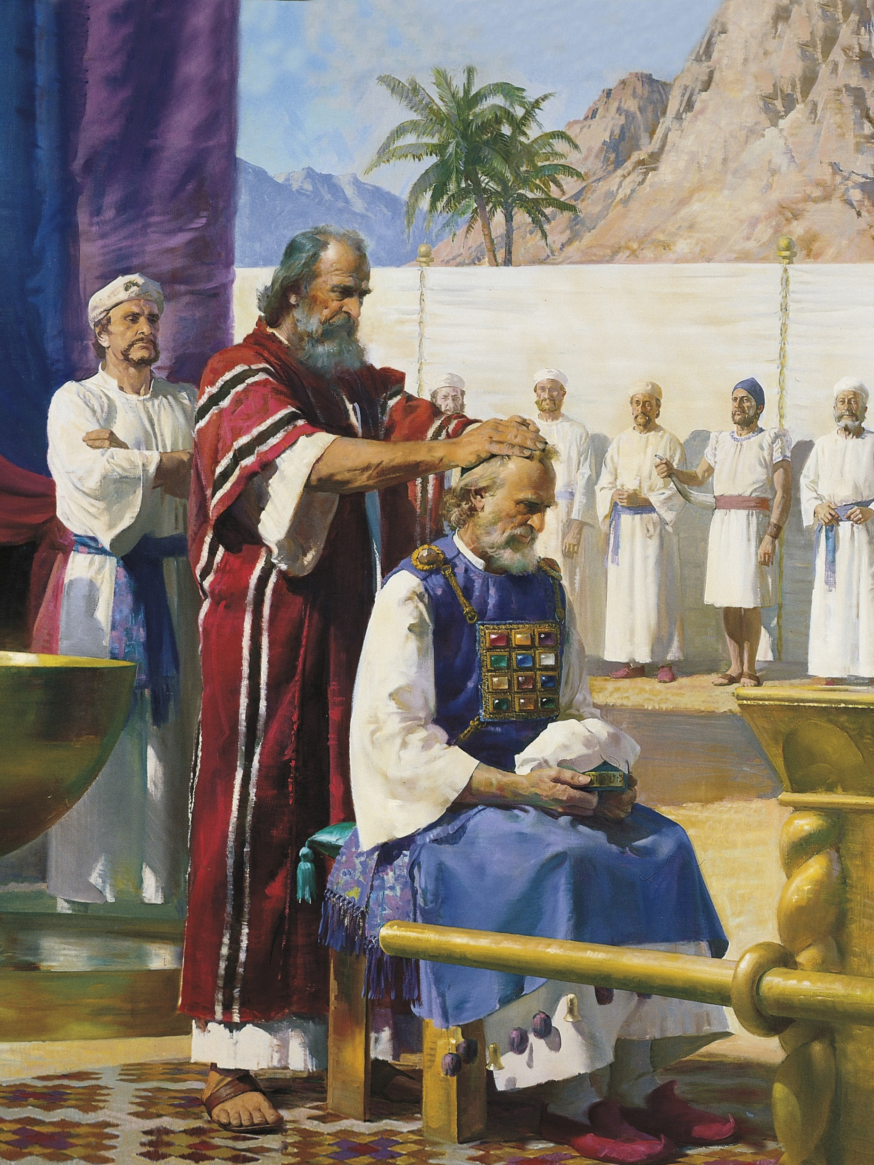
Aaron and Moses

Slide 17
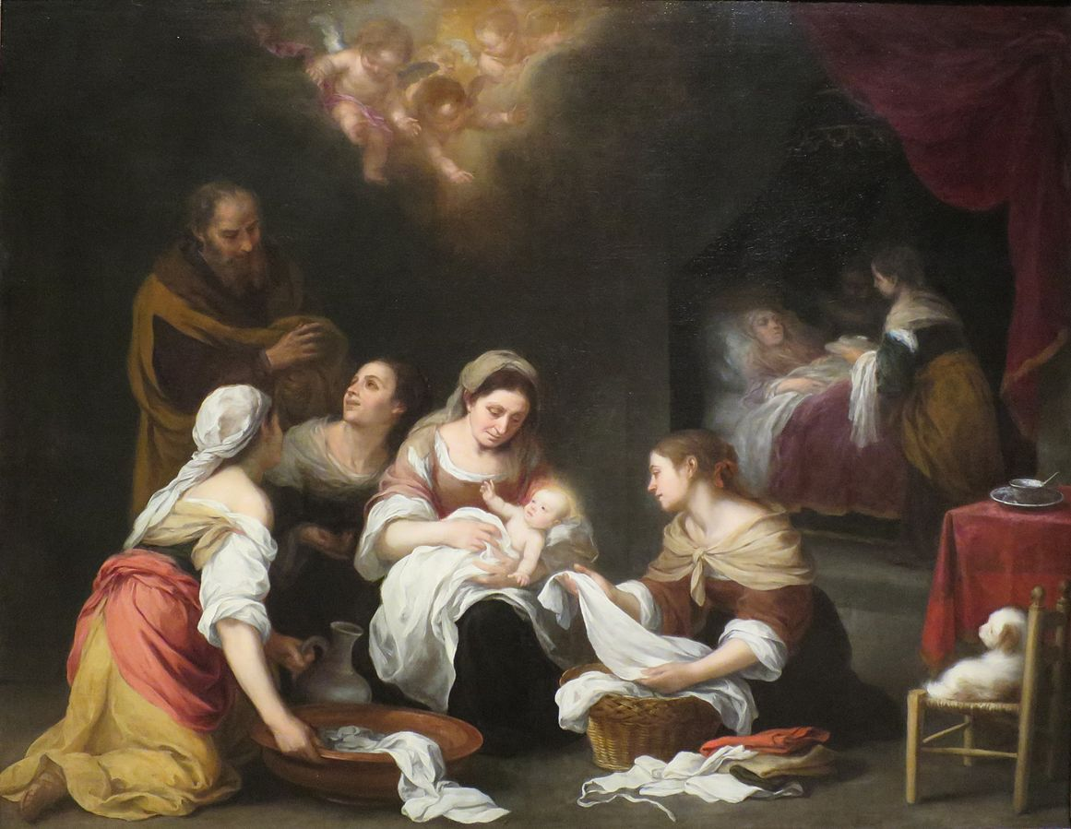
Saint John the Baptist by Bartolome Esteban Murillo

Slide 18
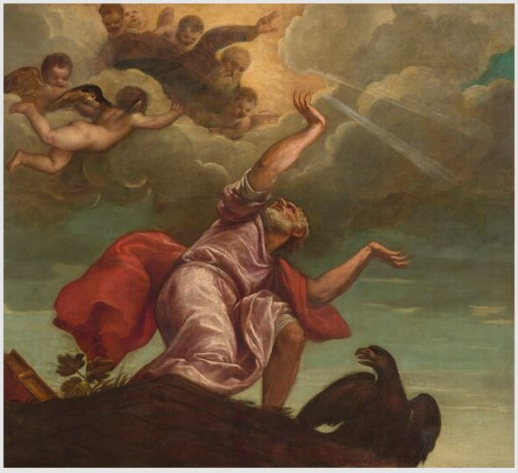
Saint John the Evangelist on Patmos

