Slide 1
The Nag Hammadi Manuscripts
A Fresh Look at Their Origins
Notes:
This Powerpoint presentation is a supplement to the paper which accompanies it, a pdf copy of which is available for download online at the Golden State College website. I have placed it on the public part of the website as there is no information in the paper that cannot or should not be shared with anyone.
The title of the paper is “The Nag Hammadi Manuscripts – a Fresh Look at Their Origins.

Slide 2
The Discovery of the Nag Hammadi Manuscripts - 1945
Notes:
The collection of manuscripts, in codex format, were discovered near the small village of Naj Hammadi, about 50 miles from Luxor. Note that the name of the village is spelled differently than the name of the manuscripts – for some unknown reason.
There are many places to read the story of the finding of the Nag Hammadi manuscripts. One good place is the Introduction to the 1979 book by Elaine Pagels, The Gnostic Gospels.
More about Dr. Pagels and her book later in this presentation.

Slide 3
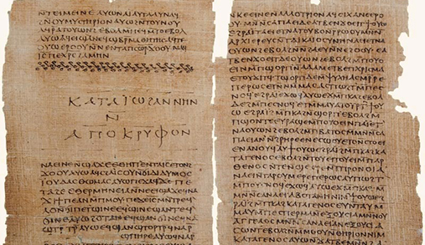
The Nag Hammadi Codices
Notes:
The manuscrips – totalling 13 – were originally written in Coptic. Coptic is actually the language of Ancient Egypt. Although Coptic is a semitic language, it was written with Greek letters.
The works were not originally written in Coptic. They are translations into Coptic from the originals written in Greek. Greek was the lingua franca of the Mediterranean World in antiquity.
The manuscripts are codices, meaning that they were originally bound as a book is bound today, rather than being scrolls. They were written on papyrus.

Slide 4
The Coptic Museum in Cairo, Egypt
Notes:
This is the Coptic Museum in Cairo – where the Nag Hammadi manuscripts are currently housed.
Photographic copies of the manuscripts are available online at the Claremont Colleges Digital Library. This is fortunate, because some of the originals in the Coptic Museum are no longer legible due to exposure to light and careless handling.
The digital collection has been at Claremont in the Institute for Antiquity and Christianity since 1975.

Slide 5
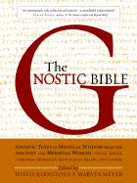
English Translations of the Nag Hammadi Codices
Notes:
These two books from my library contain the Nag Hammadi codices in English translation. These two books are in my library – and I also have a Kindle edition of each one, which makes the collection easily searchable.

Slide 6
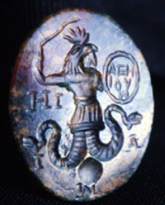
English Translations of the Nag Hammadi Codices
The Gnostic Society Library
http://gnosis.org/naghamm/nhl.html
Notes:
But if you don’t want to purchase a copy of the paper editions, nor the Kindle editions, you can read them online at this website. The Gnostic Society makes them freely available online.

Slide 7
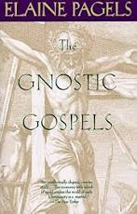
Dr. Elaine Pagels
Notes:
If you are not familiar with Gnostic literature in general, a good introduction to it is this 1979 book by Dr. Elaine Pagels.
The Gnostic Gospels was originally her doctoral disstertation at Harvard University. The Introduction to this book is one of the best summaries available on the Nag Hammadi manuscripts.
She currently teaches at Princeton University.

Slide 8
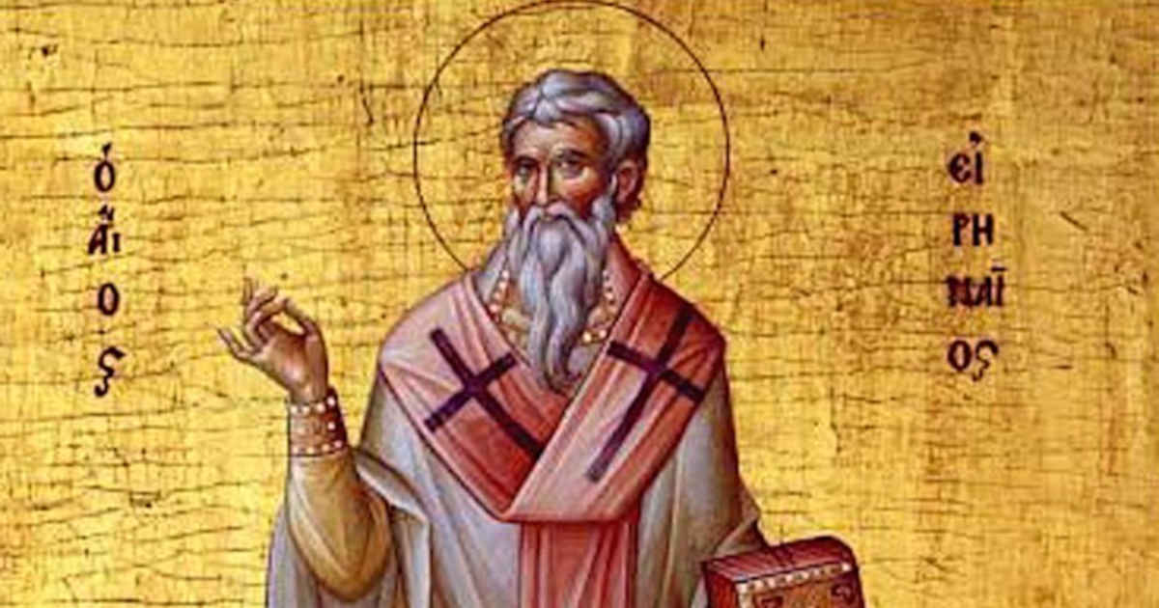
St. Irenaeus
Notes:
In her book, Dr. Pagels explains why the Gnostics were considered so troublesome to the “orthodox” Christian churches.
She believes that the problem was originally a political one rather than a religious one.
The early church had been very decentralized, with some of them developing a tri-partite clerical structure of a bishop, priests, and deacons. Unlike today where a bishop may preside over a number of congregations in a diocese, each local church had a bishop, who was assisted by a council of priests (presbyters, or elders), and who were supported by deacons. Other churches had a very casual attitude toward leadership, with these leadership positions sometimes chosen by lot.
St. Irenaeus (c. 130 – c. 202) wrote the classic defense of “orthodox” churches against the Gnostics: Against Heresies (c. 180). He was the bishop of Lyon, in modern-day France.

Slide 9
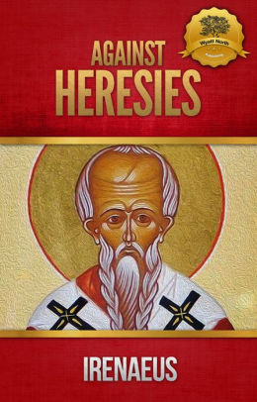
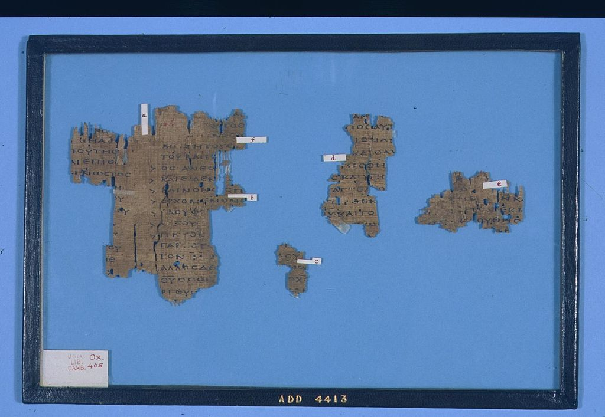
Notes:
This is an English translation of his work, originally written in Greek. On the right are fragments of the work – probably not the original, but a later copoy.

Slide 10
Notes:
Our story takes us next to Egypt, and to the most important city in Egypt during the time period when the Nag Hammadi manuscripts were translated from Greek into Coptic.
This is a reconstruction of the city of Alexandria, Egypt, which was founded by, and name for, Alexander the Great. In the center is the famous Pharos Lighthouse, one of the Seven Wonders of the Ancient World.
Alexandria was important for many reasons, not the least of which is that it was the location of the great Library of Alexandria which housed many, of not most, of the great works of antiquity.
It was also the seat of the Bishop of Alexandria, and Patriarch of the Coptic Church in Egypt.

Slide 11
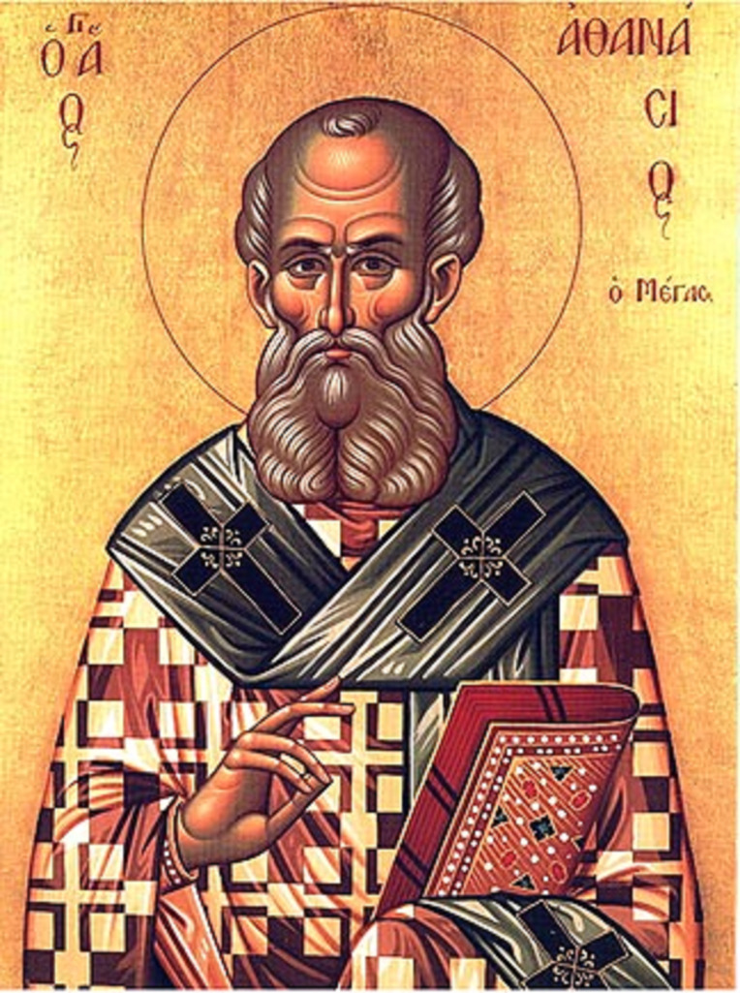
St. Anthanasius
Notes:
Anthanasius (c. 296 – 2 May 373) was Bishop of Alexandria from c. 328 until his death on May 2, 373.
He was a chief defender of Trinitarianism against Arianism.
It was his custom to issue an annual “Easter Letter,” and his letter in 367 C.E. was the first time that the 27 books of our current New Testament were listed in one place.
That is important for our story because there has been an assumption that his attack on heresy in general, and his efforts to suppress “non-canonical” scriptures may have led to the Nag Hammadi manuscripts being hidden away to save them from destruction.

Slide 12
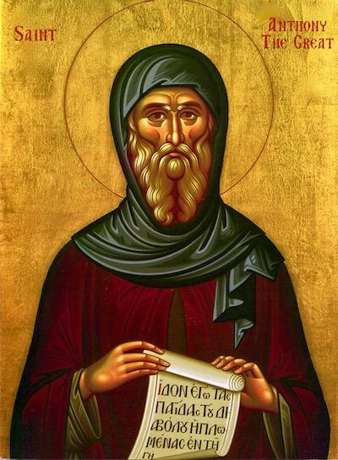
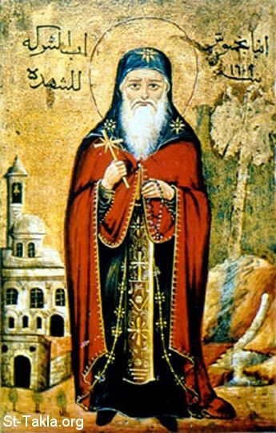
Notes:
One of the primary scholars of the Nag Hammadi manuscripts, Dr. James M. Robinson, first advanced the idea that the codices had been hidden in the desert by monks to save them from destruction at the hands of the zealous priests of St. Athanasius.
This story appears in many secondary sources today.
On the left is an icon of the founder of Egyptian monasticism, St. Anthony in Egypt, who died in 356 C.E. On the right is St. Pachomius (c. 202 – 9 May 348), who created the first cenobitic monasteries in Egypt.
Cenobitic monasteries were characterized by solidary hermits, or monks, who came together for meals in common, and to hold some prayer services in common.

Slide 13
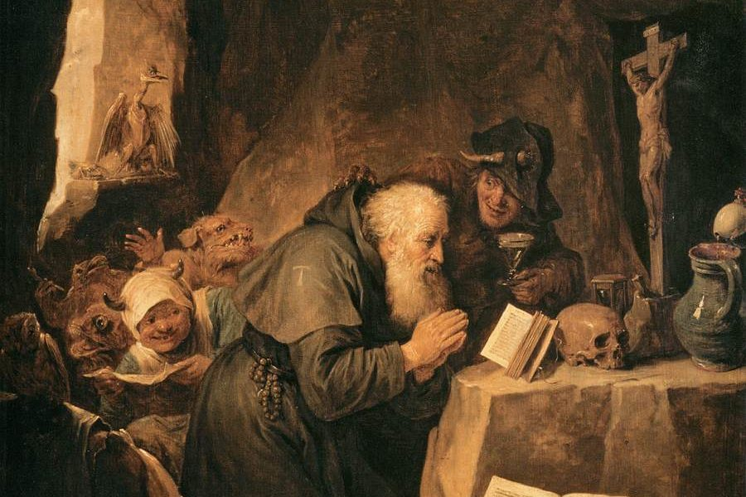
The Temptation of St. Anthony
Hieronymus Bosch
Notes:
This is a famous painting by Hieronymus Bosch, The Temptation of St. Anthony. It reflects the type of monasticism which flourished in Egypt in the Fourth Century – a devotional monasticism rather than a scholastic monasticism.
Egyptian monks were not scholars; many, if not most, of them could not read. It is therefore unlikely – according to contemporary scholarship on the subject – that Egyptian monks were the ones who originally owned the Nag Hammadi manuscripts, and who hid them away to keep them from being destroyed.
The creation of this “myth” owes more to our thinking of these Egyptian monks as if they were monks of the Middle Ages in Euorpe – which they were not!

Slide 14
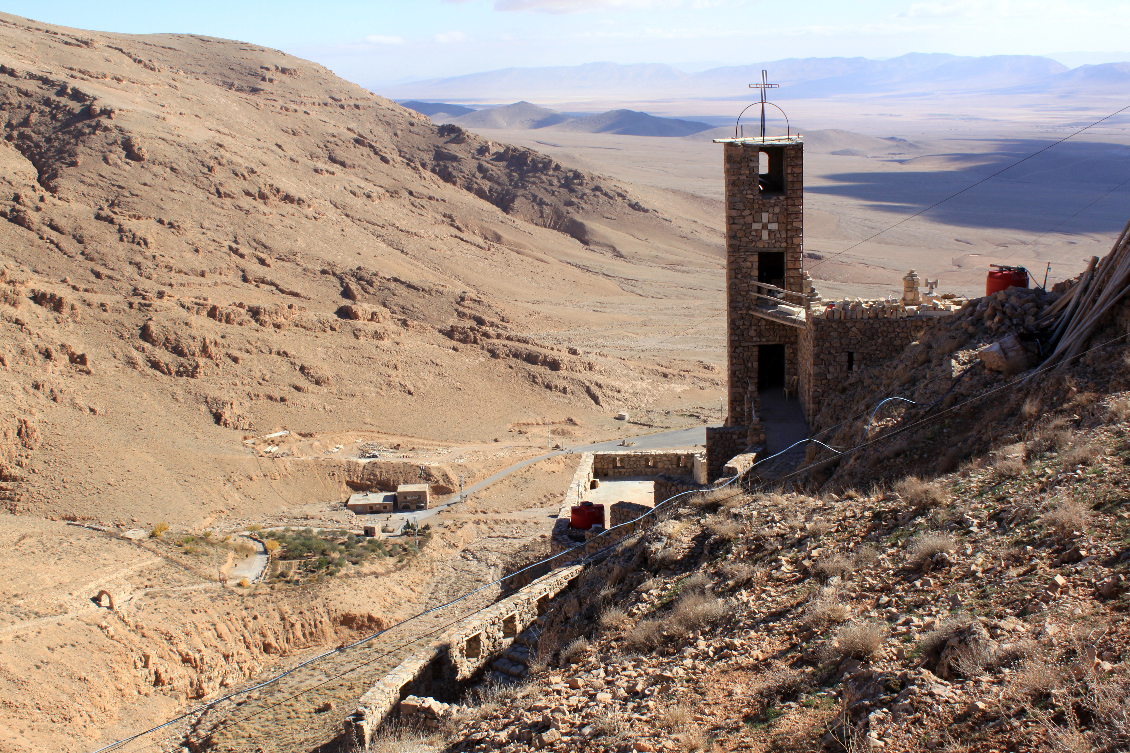
Notes:
This is a modern-day monastery in Egypt, but the monastic communities of Anthanasius’ days probably did not have purpose-built buildings like this. They lived in caves in the hillsides, and their communal buildings were probably temporary shelters – what we would call ramadas today.

Slide 15
Dr. Nicola Denzey Lewis
Notes:
This is a photograph of Dr. Nicola Denzey Lewis, who currently teaches at Claremont Graduate University. This university is familiar to me as I received a Ph.D. in Education from this school in 1985. In those days it was called Claremont Graduate School, and it served as the graduate school for the Associated Colleges of Claremont.
In 2014 Dr. Lewis published a paper in conjunction with one of her graduate students, Justine Ariel Blount, titled “Rethinking the Origins of the Nag Hammadi Codices.” A pdf copy of this paper is available from me if interested.
Rather than monks hiding the codices to keep them from the clutches of Athanasius, she thinks that they were translations from the Greek commissioned by well-to-do private citizens, who then had them buried with them when they died – a common custom in that day, according to Dr. Lewis!

Slide 16
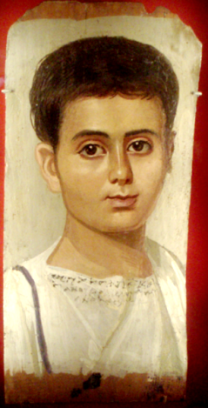
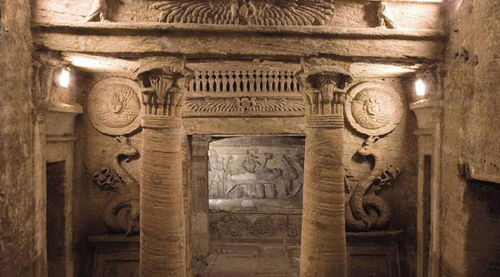
Notes:
We tend to think of burials in Egypt as Egyptian mummies, buried in pyramids or rock-cut tombs as in the Valley of the Kings near Luxor in Upper Egypt. We forget that Egypt had a history after the time of the Egyptian pharaohs – under the Ptolemies, who were the Greek rulers established by the conquest of Egypt by Alexander the Great, and then as a Roman province.
Indeed, Roman burials – mummies – are more common than any other kind in Egypt. By Roman times these mummies often had portraits painted over the face of the mummy – as in the picture here. And while the very wealthy could have constructed rock-cut tombs, such as the one depicted here, most people were buried in more modest graves in the desert beyond the reach of the Nile flood plain. And that is where Dr. Lewis believes that the Nag Hammadi codices came from – a Fourth Century Roman-Egyptian burial!

Slide 17
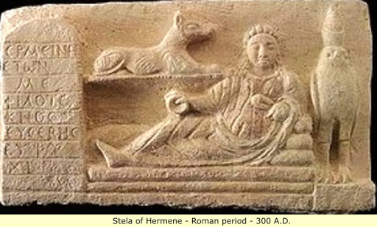
Notes:
Note in this slide the combination of traditional Egyptian motifs with Graeco-Roman burial bas-relief, and an inscription in Greek letters on the side.

Slide 18
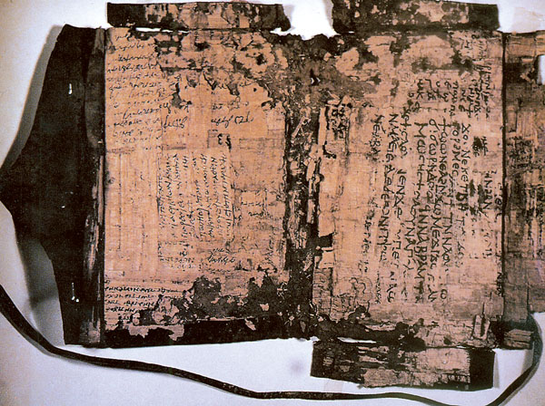
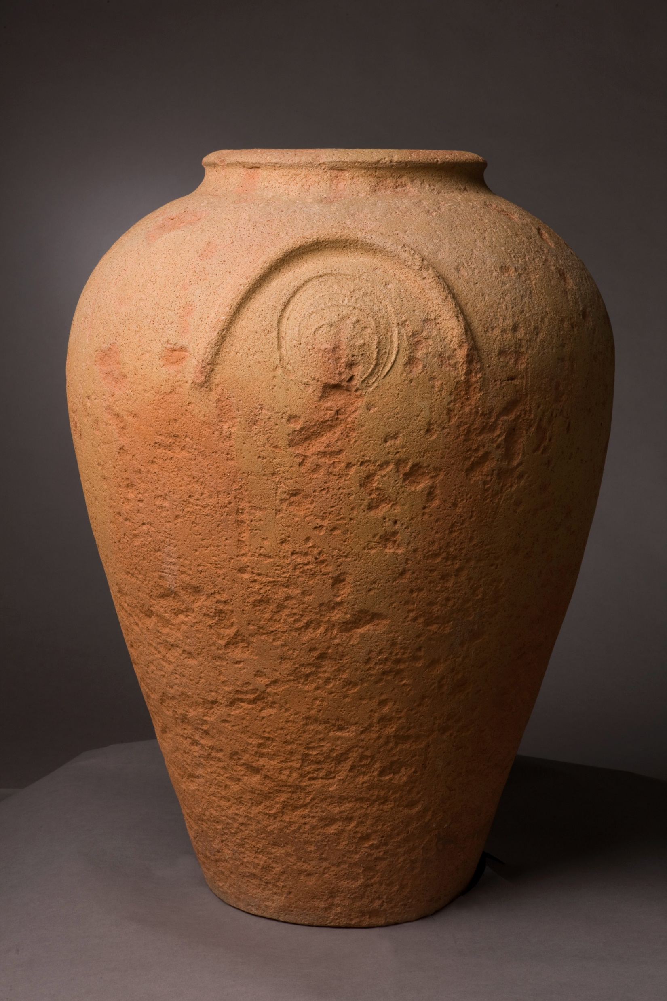
Notes:
Dr. Lewis thinks that these codices – pictured above – were much more likely to have been placed in jars such as this by their Graeco-Roman owners who buried the jars with them.
However – it should be noted that Dr. Lewis does not explain why this custom was common. It is hardly likely that these Egyptian-Romans believed that they would be reading the manuscripts in an afterlife (!).

Slide 19
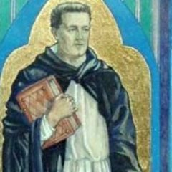
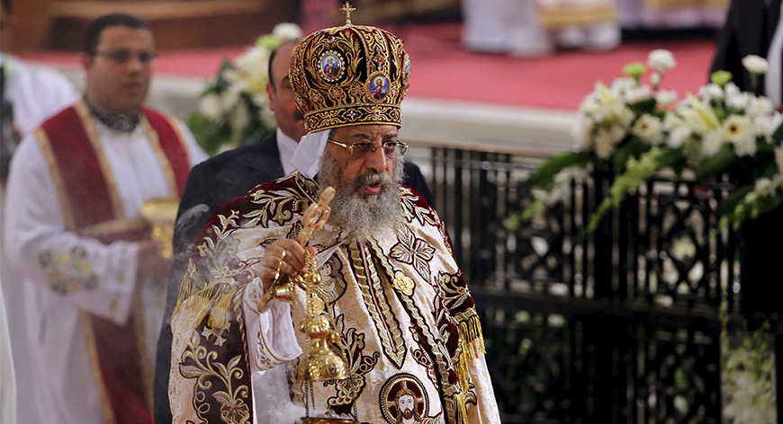
Notes:
Coptic scholar Heather Barkman, Ottowa University in Canada, adds an intriguing wrinkle to this story.
On this slide is a representation of Bishop Melitius of Lycopolos – an opponent of Anthanasius, and a “survivor” of the Great Persecution of Diocletian which began in 303 C.E.
When the Great Persecution began, many Christians succumbed to the pressure to give in to the requirement that they sacrifice to the genius of the Emperor – in the Roman view, “Pledging Allegiance” to the Emperor. After the persecution had ended in 311 C.E., the churches had to decide what to do with these lapsed Christians.
Some bishops – including Melitius – did not want to admit Christians who had “renounced Christ” to Holy Communion. Other bishops – including Athanasius – took a more lenient view. This caused a schism in the church – and not just in Egypt.

Slide 20
Notes:
This is a photograph of Dr. Heather Barkman, of Ottawa University. She published a paper in 2014 describing this controversy in the Egyptian church.
It is possible that the codices were hidden away by their owners not as “burial goods,” but to protect the owners from being found out as Christians by the Roman authorities during the Great Persecution.
It is also possible that the codices were hidden during the “Melitian Schism” to keep them out of the hands of both parties to the controversy – Bishop Melitius as well as Bishop Athanasius.
To some that makes more sense that the idea that monks hid them or that they were buried along with their owners.

Slide 21
Searching for a book …………………….
Notes:
So that’s the story of an alternative origin of the manuscripts. They may have been hidden away by monks as suggested by Dr. Robinson, and as repeated by other scholars since their discovery in 1 945.
Or they could have been buried with their owners – wealthy Egyptian-Roman citizens, who owned and read these Gnostic treatises.
Or they could have been hidden away by these same citizens to keep themselves out of trouble with both the Roman state and their own churches. We may never know.
HOWEVER, the story will continue to be researched. On this slide I have a picture of a book that I would like to add to my library on this subject. Unfortunately it is out of print, and I could not find a copy in any of my usual sources. So I thought that I would show it to you here, with the possibility that if any of you should come across a copy, that you would let me know!

Slide 22
Notes:
That’s all folks!
Questions?

