Slide 1
English Illuminati Including the History of the Order of the Illuminati and the Mysteries of the Illuminati Plus the revived Illuminati Rituals and Ordinances Book Review Presented by Patrick Gage Bailey IX Grade Golden State College SRICF patrickgbailey@sbcglobal.net August 22, 2021

Slide 2
English Illuminati Including the History of the Order of the Illuminati and the Mysteries of the Illuminati Plus the revived Illuminati Rituals and Ordinances Book by Alistair Lees 232 pages First Published 2019 Thank You to Frater John L. Cooper III For Presenting A Lecture About This Book Last Year at GSC on May 31, 2021!

Slide 3
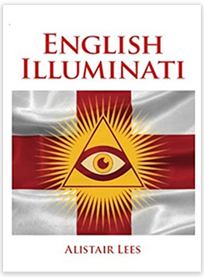

Slide 6
If you had the means –
What would you really like to know?
Can you really get information on both side of an issue?
The TV, newspapers, magazines and books all push a one-point-of view –
Because it sells! They get money for it!
They get PAID for pushing that one-point-of-view!
They are in it for easy profit and to make their local readers happy!
So how can you find out about the “other side of any issue”?

Slide 7
Q - How can we see both sides of these issues? Such as -
Republican ideas to fix the economy in CA?
Cures for COVID not authorized by the CDC?
How to easily get alternate COVID treatments,
Like Hydroxy Chloroquine & Azithromycin & Zinc Protocol?
Like Ivermectin and Zinc Colloid?
What is really happening with Sun?
Is “global warming” really “man-made”?
What did Jesus really say to eat, to drink, and to do?

Slide 8
A - We can create an “Illuminati Group” to Find and Share the Answers!
It could be based on a Masonic Lodge format!
It could have various levels of membership with men AND women!
Each level with its own Formal Degree with Ritual!
Apprentice
Member
Master
It could share such information at its meetings!
Could we start one today?
Too Late!...

Slide 9
It was already started in 1776 in Bavaria!

Slide 10
The Purpose of the Illuminati Orders and Their Revival
“This then is the story of the revival of a non-religious secret society, whose only aim originally was the further enlightenment and education of ordinary men, women, and children, at a time when women and children had no access to any public or formal education, and even then severely limited to only a few church schools and universities. “
The Original Illuminati Order (Bavaria) Formed in 1776
History relates that the “Original Illuminati Order” was established in Bavaria (located in southern Germany) in 1776. It was then known as the “Bavarian Illuminati” and was organized by several “High Grade Masons” of the time.

Slide 11
Purpose
The purpose of this paper is to show that
the objective of each of these “Illuminati Orders” was
to provide important information to their members
to educate them in the TRUTH of the matters of their times,
to support and allow women members, and
to provide Masonic Brotherhood amongst its members and
their Grand Lodges
on a level higher than ordinary Masonry would allow at that time!

Slide 12
In May 1776 the Order of Illuminati was planted in America.
“[Edmund] Burke initiated Thomas Jefferson, and the later started a Society of Illuminati or Lodge at the William and Mary University in Virginia.”
“When in the great revolutionary war this university went down [was destroyed] , the students and professors who constituted the major portion of the members of the Society of The Illuminati continued it
as the Yale University.”
“The Lodge at the Yale University made an alteration in the name
of the order, in as much as they gave it to the name of
The Phi – Beta – Kappa Society.”

Slide 13
History of the Revived Illuminati Orders From 1877 – 2020
There were several original organizations created and named the “Illuminati Order” during 1877 - 1901.
The first was created in Munich Germany, another in Berlin Germany, another in Dresden Germany, and another in Hamburg Germany.
They eventually merged into one organization with that name.
They were together known as the “Prussian Illuminati.”
Munich and Dresden unite in 1899 into the “Munich Illuminati Lodge”
(p 188)
The English Illuminati Order was Proposed 1901 (p 187)

Slide 14
“There are truths, certain holy truths, which give to mankind some explanation regarding their former, present and future existence.
Amongst these various wisdom schools, which teach such holy matters, and which work for the good of all men, the most important is the Order of the Illuminati.
Now is the time when such a school of wisdom is most necessary. The world has attained such a false spiritual direction, that one must really start again from the beginning, before one can instruct mankind in the higher wisdom. They must be made sensitive for the wisdom again.
The members of the Order of the Illuminati are in in a position to do this. But they do not desire that their word should be taken for this, but only that they should be judged according to their works.
They have secrets, but they use them only for the good of mankind.”

Slide 15
“The Order teaches:
God can only be worshipped in spirit, in quiet, without words and outward signs. To grow like him is the greatest service you can render him. A silent, earnest prayer is the best kind of worship most agreeable to him.
God appears to and discloses himself also to chosen people.
The secret power of Theurgy, which makes those who have knowledge of it the masters of nature.
Theurgy is a real science, which connects the earthly with the supernatural.
How to heal sickness naturally. How to prolong life.”

Slide 16
“They adhere to strict moderation and seemliness. Each members is shown a point of view according to which he must act.
Such a man or such a woman would be welcomed by the Order. The same does not labour to benefit himself, for the members themselves decide their contribution. Entry into the Order must be sought with longing and with unbound faith.
Truth
Love, Light, Life
Patience – Fervor
Discretion.
(Secrecy)
FINIS
Every Sin reaps its own reward.”

Slide 17
William Westcott is Proposed to Found the English Illuminati Order in Great Britain in 1901 -
Due to the apparent success of these organizations in Germany, Ruess, the founder of these organizations, decided to extend the Illuminati Order into Great Britain, and then hopefully into America. For that purpose the help of William Wynn Westcott was solicited to form “the “English Illuminati” in 1901.
The story is described in my paper. In summary –
By 1902 he [Wescott] had been the head of the now flourishing order of Rosicrucian Freemasons for ten years. They were called the ‘Societas Rosicruciana in Anglia’ (S.R.I.A.). He had been a member for twenty two years.

Slide 18
The End of the English Illuminati
William Westcott found that the Illuminati’s ‘Rose-Croix Grade’ degree was too much like the 18 degree ‘Ancient Accepted Rite, Supreme Council 33 degree Prince Rose-Croix’ degree used in England.
Using this ritual would violate the Masonic agreements as set forth in the Grand Lodge of England.
Therefore Westcott declined to pursue the establishment of the “English Illuminati” in Britain - as carefully stated in his letter to Ruess on October 16, 1902. This essentially ended the history of the “English Illuminati”.

Slide 19
But what was the Real Reason?
It is down to us to piece together what happens next! But the formal official end of the roller-coaster ride was in fact a four page letter from Westcott to Reuss on 16 October 1902 (see fig. 47) and the transcripts (fig. 498).
So, the real reason of cancelling of the idea of taking the ‘Revived Prussian Illuminati Order’ named as the ‘English Illuminati” from Germany to Britain and then possibly to America - was not the issue of this one degree. No. It was really Westcott’s personal worry about causing future trouble within the United Grand Lodge of England, and making very big waves within English Masonry!
One Wonders… Could the ‘English Illuminati be revived today, in the form of a different organization?... Why not? !!!

Slide 20
The Revived Illuminati Objectives, Regulations ,and Rituals
These are all discussed in Chapter IV in great detail, for each of the three Grand Lodges. (p 121-156)
My objective here is to show that their objectives
are truly worthy of emulation!
We desperately need these same objectives
on the internet and
in the press and
in the social media platforms and
on the TV news today!

Slide 21
The Revived Illuminati Objectives, Regulations ,and Rituals
Purpose
To advance the spiritual and social life of the members of the Order by the improvement of their culture and thus to elevate and perfect their religious and moral character.
To enable members to benefit by each other’s help and support both spiritually and materially, particularly in cases of undeserved adversity.
The purpose of the lodges does not extend to the furtherance of business affairs.
The remaining details are found in full in my paper.

Slide 22
Conclusions
These organizations were founded to extend the principles of Masonry ABOVE their existing Grand Lodge level, to allow the discussion of a wide range of natural and various subjects, and to even allow women as members. They were VERY SUCCESSFUL during their early years!
The objectives of the English Illuminati were (and still are) very inspiring – and the benefits to membership were open to all!
The power of the organization was held at the Illuminati Order Grand Lodge level, where the rules for the formation and operation of its Lodges were documented.

Slide 23
The Next Step
My final conclusion is that the “Illuminati Order of America”
could and should be formed immediately in the USA!
And organized as an international world-wide organization!
This is desperately wanted and needed in America - and everywhere else - due to the overt suppression of real facts and data by politics, by funding, and by financial kickback schemes – in and by the television, the press, the newspapers, and the news networks. This is not politics. – This is overt suppression!
As Masons, we cannot join another organization calling itself a “Lodge” that operates “With Ritual”. To do so would violate our Masonic obligations and we would be expelled from our own Grand Lodges.

Slide 24
We could form a separate “Educational Society” that would have similar operations to these Illuminati Orders and Lodges, without ritual or degrees - and we could FORCE the Truth about current events to become available, publicized, and known!
An “American Educational Illuminati Order University” with local chapters could be formed with similar objectives and rules as set forth above, without any ritual or degrees. They could in turn function as new and independent “Illuminati Press Clubs” to obtain and publish information. Such new investigative research and unbiased reporting is desperately needed today in the USA!
The creation of the “American Illuminati Educational Group” is a worthy and desperately needed goal!
And it is needed now!

Slide 25
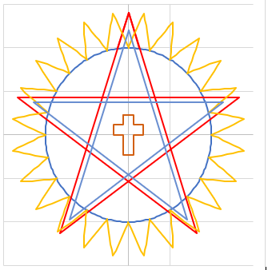
The American Illuminati Educational Group
Is a worthy and desperately needed goal!
And it is needed now!
Please contact me if you would assist in this quest!
Patrick G. Bailey, IX Grade
Golden State College SRICF
Librarian and Webmaster
patrickgbailey@sbcglobal.net

Slide 26
References
English Illuminati – Summary Book Report
Paper by Fra. Patrick Bailey IX Grade, Librarian, GSC SRICF, Presented on August 22, 2021
https://gscsricf.org/files/public-papers/bailey_082221.pdf
Hermetic Order of the Golden Dawn
https://hermeticgoldendawn.org/
ITALIAN POLICE SEIZE MEMBERSHIP LISTS OF MASONIC LODGES –
The P2 Masonic Lodge Affair in Italy
By Henry Tanner, Special To the New York Times - June 10, 1981
https://www.nytimes.com/1981/06/10/world/italian-police-seize-membership-lists-of-masonic-lodges.html
A Coronavirus Information Website
http://www.padrak.com/coronavirus/

Slide 28
End of Presentation.
Articles from the Internet Follow –
For Your Consideration…

Slide 29
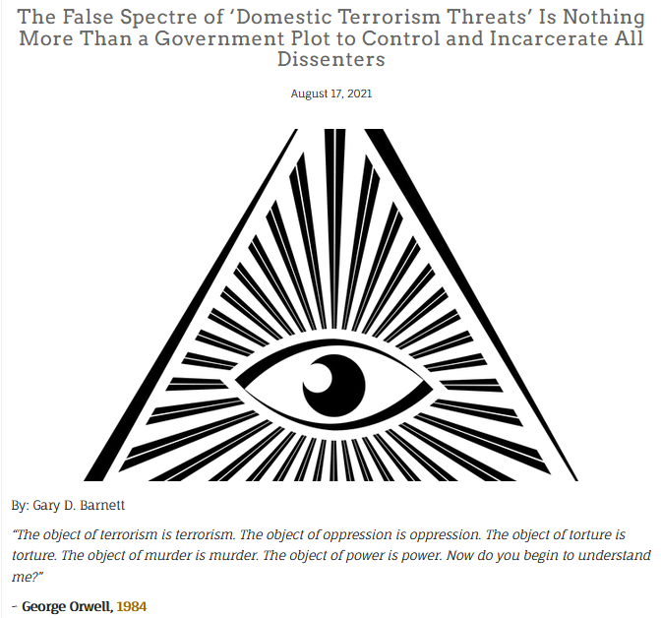
https://www.garydbarnett.com/the-false-spectre-of-domestic-terrorism-threats-is-
nothing-more-than-a-government-plot-to-control-and-incarcerate-all-dissenters/

Slide 30
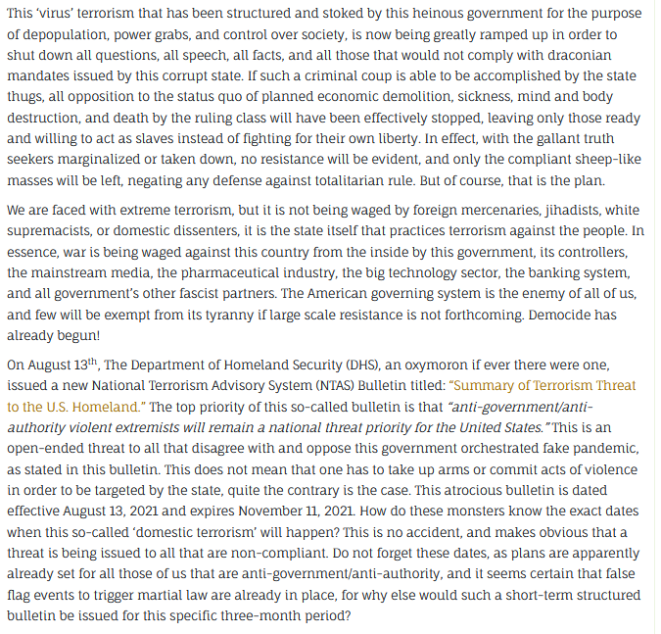

Slide 31
TotalControl666
https://www.bitchute.com/video/XbdCiPwoQp4T/#TotalControl666%C2%A0
%236uild6ack6etter%23globalStockholmSyndrome%23ID2020

Slide 32
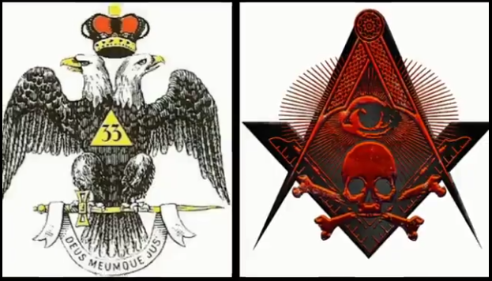
TotalControl666
https://www.bitchute.com/video/XbdCiPwoQp4T/#TotalControl666%C2%A0
%236uild6ack6etter%23globalStockholmSyndrome%23ID2020

Slide 33
